Slide 1

“NLP-NAMED ENTITY RECOGNITION IN INDIA”
SIR M. VISVESVARAYA
INSTITUTE OF TECHNOLOGY
BENGALURU-562 157
DEPARTMENT OF COMPUTER APPLICATIONS
PROJECT ON
Project Guide: Dr. Ch. Vanipriya
Professor and HOD,
Dept of MCA
Sir MVIT
Submitted By: Syed Asgar Ahmed
1MV21MC056

Slide 2
Agenda:
1. Introduction
Project Description
Objective
2. Literature Survey
Existing and Proposed system
H/w and S/w requirements
3. Detailed Design
DFDs (Level-0, Level-1)
Use case Diagrams
Algorithm
4. Implementation and Testing
Screen shots
Test cases
5. Conclusion and Future Enhancement

Slide 3
1. Introduction:
1.1 Project Description
Named entities are typically proper nouns, such as person names, organization names and location names.
NER is a challenging task for Indian languages, due to diversity of Indian languages and the lack of resources to train NER systems.
The field of named entity recognition (NER) for Indian languages has seen a growing interest in recent years.
Most popular NER algorithms for Indian languages include:
CRF (Conditional Random Fields)
Stanza
Spacy
Nameparser

Slide 4
1. Introduction:
1.1 Project Description
The project compares the performance of four NER algorithms for Indian languages: CRF, Stanza, Spacy, and Nameparser.
The accuracy of each algorithm is calculated using a dataset of Indian names, and the results are compared across various Indian languages.
The experiments reveal that CRF achieves the highest accuracy, followed by Stanza, Spacy, and Nameparser.
The objective of the study is to evaluate these four NER algorithms in the Indian context, specifically CRF, Stanza, Spacy, and Nameparser, to determine the most effective algorithm for NER tasks in India.

Slide 5
1. Introduction:
1.2 Objective
The objectives of this study are as follows:
To compare the performance of four different NER algorithms in the context of Indian languages.
To identify the strengths and weaknesses of each NER algorithm in the context of Indian languages.
To recommend the most appropriate NER algorithm for a particular application.
The study has been conducted by using a large dataset of Indian names. The dataset used to train and evaluate the four NER algorithms. The results of the study is presented in the form of a comparison graph that shows the accuracy of each NER algorithm to determine the most effective algorithm for NER tasks in India.

Slide 6
2. Literature Survey:
2.1 Existing System
The study rectifies following limitations of Existing System
The NER model with the context of India is “MAHANER”. This is language specific model made only for Marathi language.
The general model for NER is not available with the context of India.
Difficulty to perform NER with the Marathi NER model. To perform NER Marathi should familiar.
Facing difficulties in NER.
In many areas the MAHANER will not works.
There is no such general-purpose model to perform Natural Language Processing (NLP) in context of Indian text.

Slide 7
2. Literature Survey:
2.2 Proposed System
The proposed system aims to address the limitations of the existing NER algorithms for Indian languages by introducing a comprehensive-evaluation and comparison framework.
This system seeks to improve/increase the accuracy and effectiveness of Named-Entity-Recognition in the Indian language context.
Based on the findings, the study will recommend the most appropriate NER algorithm for specific applications within the Indian language context.
The following are the key components of the proposed system:
A rule-based system for identifying basic types of named entities.
A machine-learning algorithm for classifying the named entities into more specific categories.
A data set of Indian names for training the machine-learning algorithm.

Slide 8
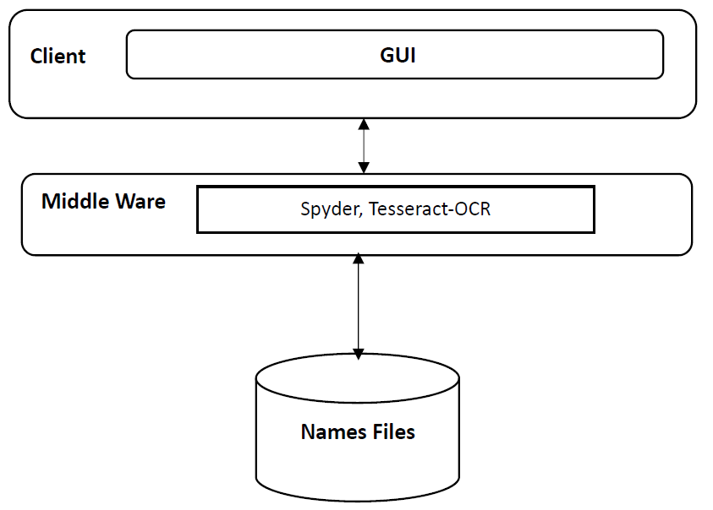
2. Literature Survey:
Architecture Diagram:

Slide 9
2. Literature Survey:
2.3 Hardware Requirements
Processor: Intel Pentium Dual Core or higher
Speed: 2.2GHz or faster
RAM: 4 GB or higher
Hard Disk: 500 GB or more
2.4 Software Requirements
Operating System: Windows 7/above
Coding Language: Python

Slide 10
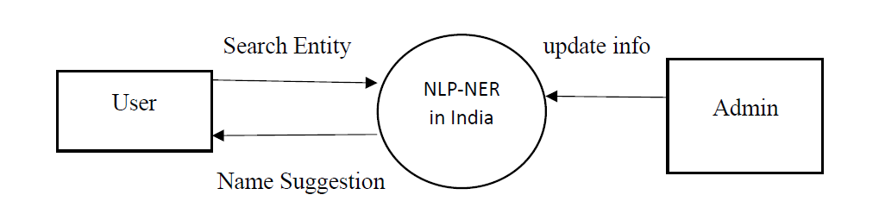
3. Detailed Design:
3.1 DFD
Level – 0
Fig 3.1.1 DFD Level - 0

Slide 11
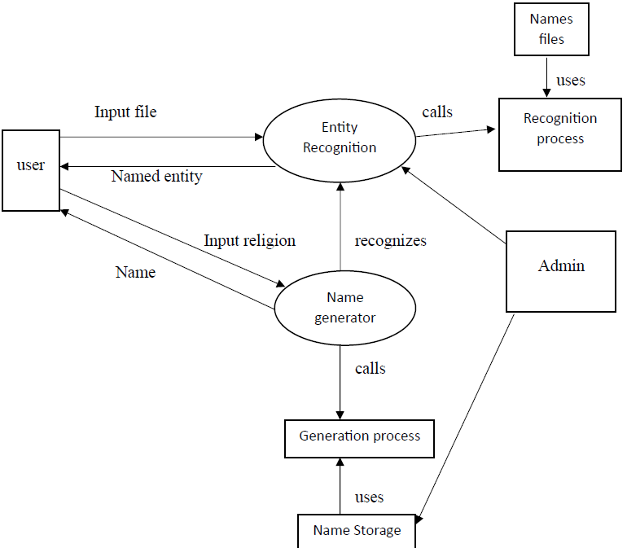
3. Detailed Design:
3.1 DFD
Level – 1
Fig 3.1.2 DFD Level - 1

Slide 12
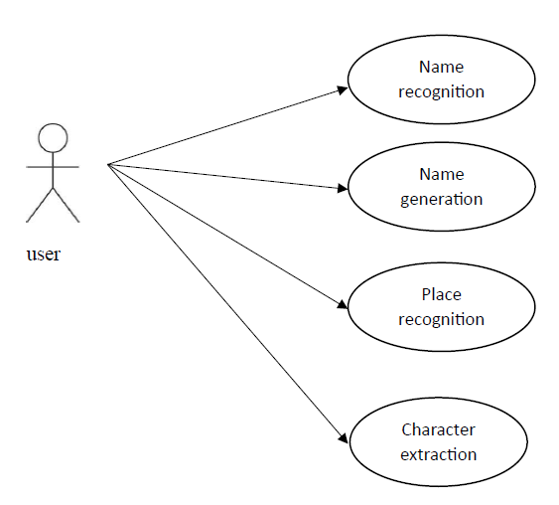
3. Detailed Design:
3.2 Use case Diagram
Fig 3.2 Use case diagram

Slide 13
3. Detailed Design:
3.3 Algorithm for Entity Recognition
Start
Read file
Extract text
Separate keywords from extracted text
Recognize name, state, district etc..
Display result
Stop

Slide 14
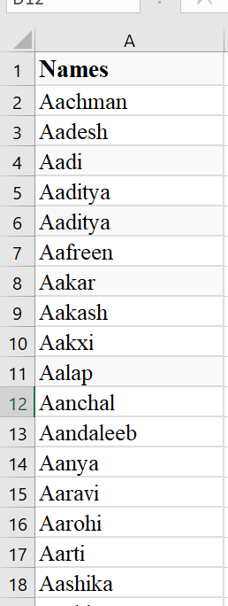
3. Detailed Design:
3.4 Sample Name List:

Slide 15
4. Implementation and Testing:
4.1 Sample Code
# Function to perform OCR on an image
def ocr_iteration1(image_path):
reader = easyocr.Reader(['en'])
result = reader.readtext(image_path)
res = ''
for i in range(len(result)):
res += result[i][1] + '\n'
print(res)
return res

Slide 16
4. Implementation and Testing:
4.2 Screenshots
Fig 4.2.1. Initial Page.

Slide 17
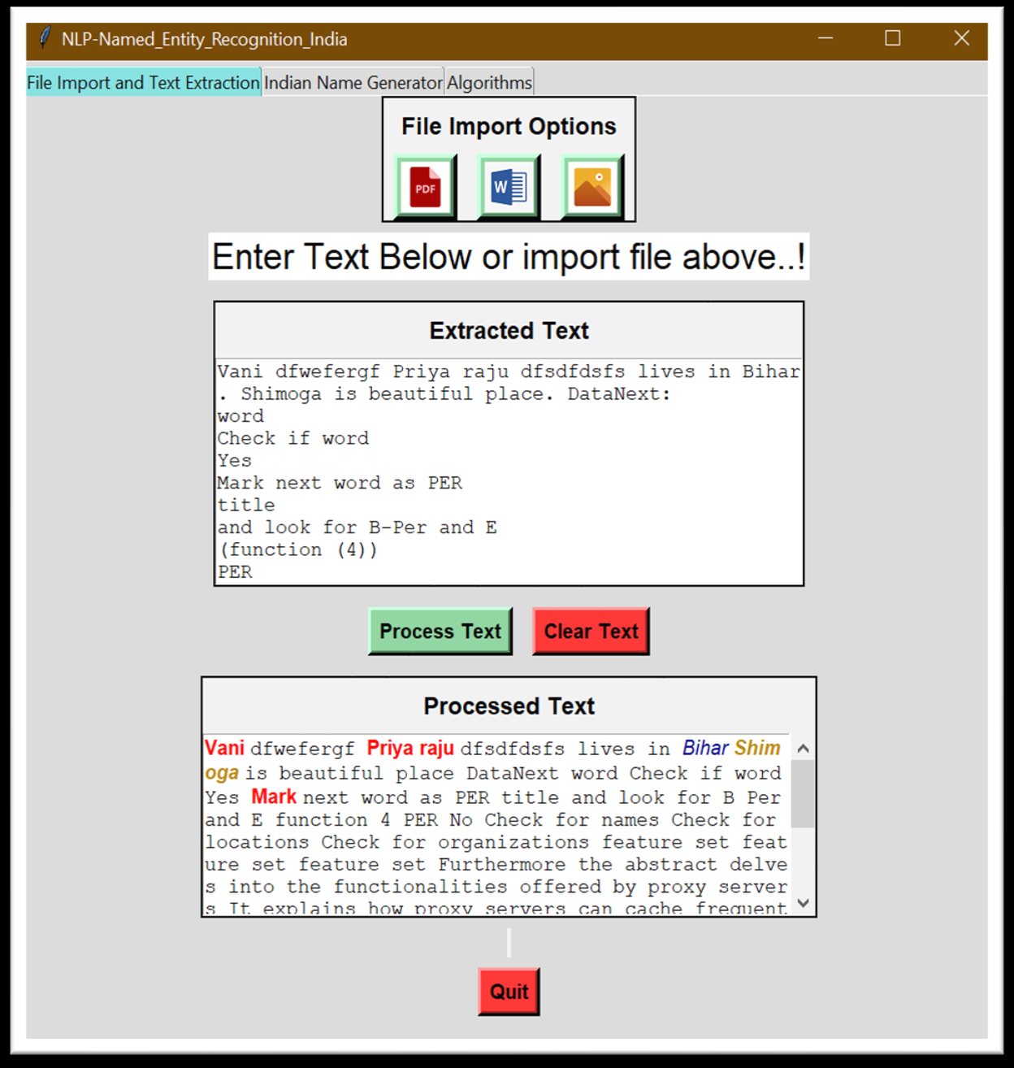
4. Implementation and Testing:
4.2 Screenshots
Fig 4.2.2. Text Imported from a PDF.

Slide 18
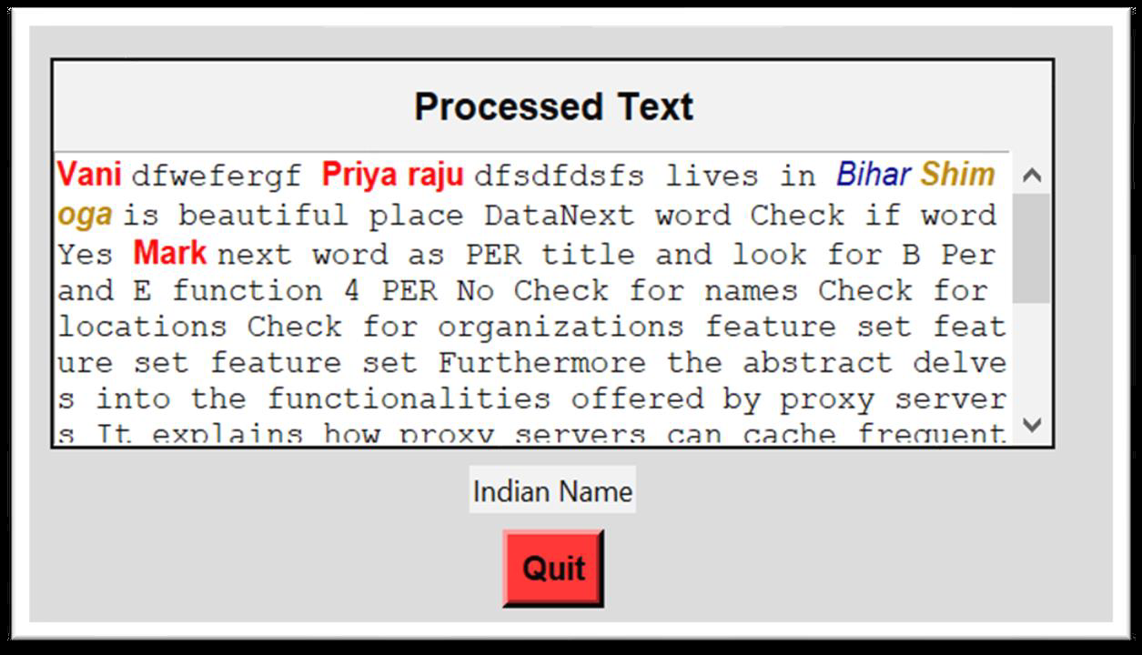
4. Implementation and Testing:
4.2 Screenshots
Fig 4.2.3. Cursor placed on highlighted text and label changed as Indian name.

Slide 19
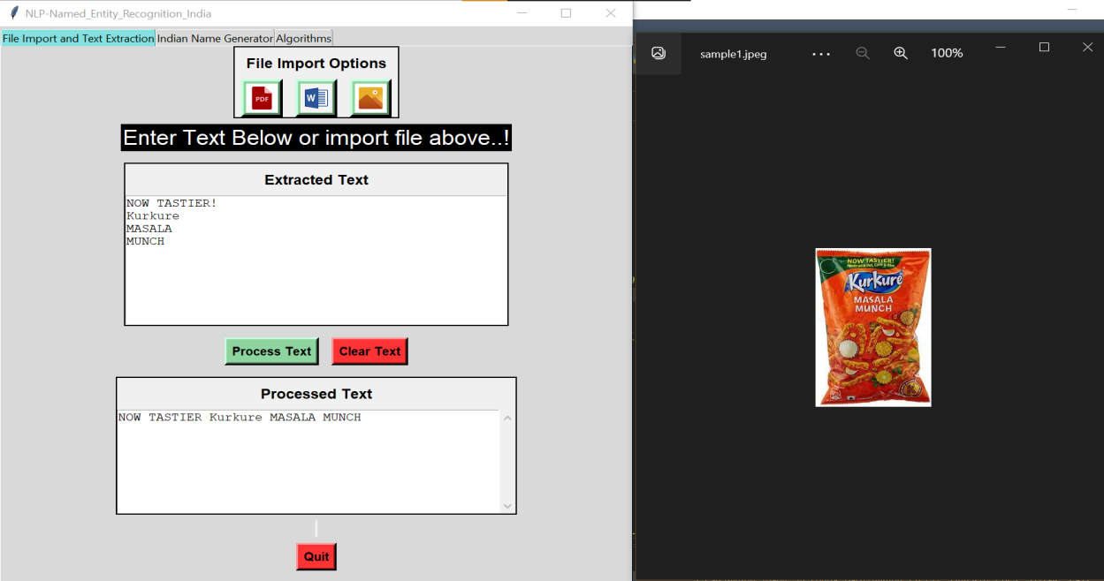
4. Implementation and Testing:
4.2 Screenshots
Fig 4.2.4. Text extracted from an image.

Slide 20
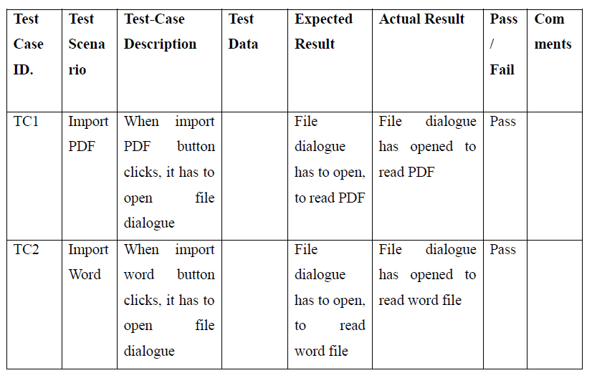
4. Implementation and Testing:
4.3 Test Cases

Slide 21
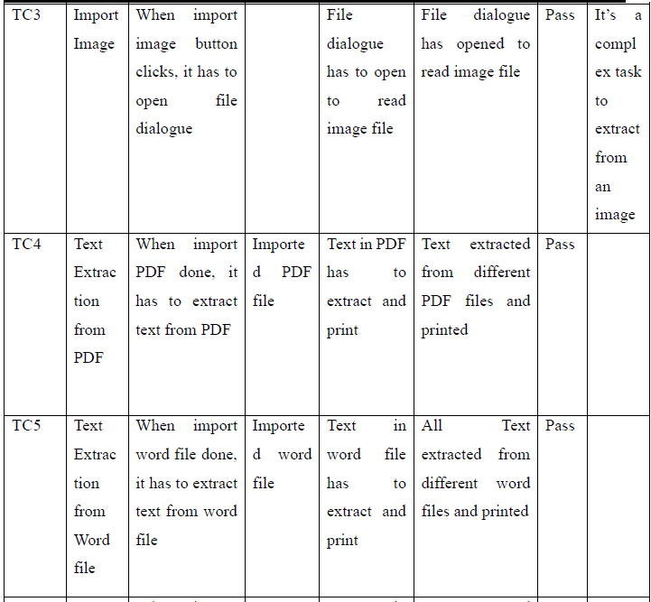
4. Implementation and Testing:
4.3 Test Cases

Slide 22
5. Conclusion and Future Enhancement:
5.1 Conclusion
Named Entity Recognition (NER) is a crucial task in NLP, involving identifying and extracting entities from text. In the study, using a dictionary was found to be the most effective approach for NER on Indian names. Overall, the results of this study suggest that the use of a dictionary is the best way to perform NER for Indian names. The dictionary-based approach achieved significantly higher accuracy compared to other models.

Slide 23
5. Conclusion and Future Enhancement:
5.2 Future Enhancement
To Improve Training Data: Collect more representative data for training NER algorithms on Indian names to ensure better coverage and accuracy.
To Develop Enhanced Algorithms: Create algorithms that better handle the complex morphology and syntax of Indian languages, improving NER performance.

Slide 24
Thank You

